Slide 1


Analysis of
Follower
Interactions
Devin Dupree, Nicole Barnason, Diana Nguyen
Interactions Metrics Project
Cognitive Engineering | HCI 6810 2 | Fall 2024

Slide 2

Twitch Metrics
Twitch, owned by Amazon and launched in 2011, is a top live-streaming platform for gaming, creative arts, music, and more. It connects creators and viewers with real-time interaction through live chat and diverse content like tutorials and talk shows. Twitch’s Affiliate and Partner Programs help creators monetize, making it a hub for community and career-building.
1.3 Trillion
Minutes Watched in 2023
7.3 Million
Unique creators streams per month
51,480
Partnered streamers since
1.7 Billion
Video clips viewed 2017
31 Million
Unique daily visitors
150,000
Affiliate streamers in 2020
Notes:
.

Slide 3





Streamers Create Content
Increase Streamer
Revenue
Followers Watch
Streamers
Followers Monetize Streams

Slide 4
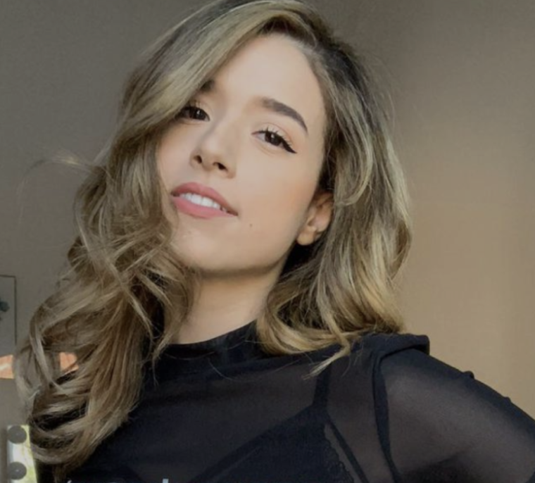
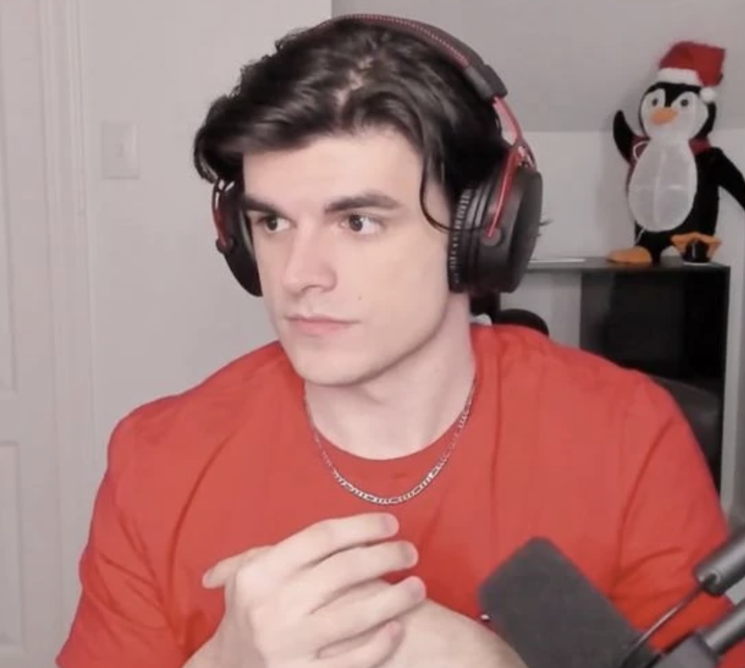


Twitch streamers
Top Tier
Pokimane
9 million followers
Mid Tier
Foolish Gamer
2.2 million
Low Tier
Friskk
50,000

Slide 5

Methodology
1
Approach
Collected streams and chat log data
Active & passive metrics
4
Observations
Active engagement metrics
Passive Metrics
Chat dynamics between top-tier, mid-tier, and low tier streamers and their audiences
2
Data Collection
Chat logs
Stream Metrics
3
Analytical Tools
Data Parsing
Regression Analysis
Notes:
Our study focused on understanding interactions between Twitch streamers and their audiences, and this slide outlines our methodology.
First, our approach involved collecting data directly from Twitch streams and chat logs for our selected streamers. We focused on both active engagement metrics, like chat messages and emotes, and passive metrics, such as viewer retention and subscriptions.
For data collection, we analyzed chat logs to evaluate total messages, unique chatters, and engagement patterns. We also examined stream metrics like viewer counts, subscription levels, and the use of commands and emotes.
We employed analytical tools like data parsing to process quantitative metrics, such as message rates and emote usage. Additionally, regression analysis helped us identify trends in engagement and interaction metrics across different streamer tiers.
Lastly, our observations revealed that active engagement metrics, such as chat participation, were most significant for smaller streamers. In contrast, passive metrics like viewer retention provided deeper insights for larger streamers. These differences highlighted unique dynamics across top-tier, mid-tier, and low-tier streamers

Slide 6
Metrics
1
Data Sources
Top-tier, mid-tier, low tier streamers
4
Chat log analysis
Total messages and message rate
Emotes used per chatter
Density of question in chat
Streamer Transcripts
2
Active Engagement
Count of questions
High chat participation
Use of active commands (!vote)
Donations, tips, subscriptions
5
Viewership Stats
Total viewers and unique views
Followers growth and lurker ratio
3
Passive Engagement
High view count & long retention rates
Lurker percentage
[(Total viewers - active chatter]/total viewers)
6
Regression Analysis
Explored relationship between engagement metrics and audience behavior
Notes:
Our research focused on evaluating follower interactions with three key metrics: engagement rate, retention rate, and overall activity levels.
Engagement rate measures the frequency of active participation during streams, such as chat contributions, command usage, and donations.
Retention rate tracks the percentage of followers who return to watch subsequent streams, highlighting long-term audience loyalty.
We applied these metrics by calculating engagement rate as the ratio of active chat participants to total viewers and retention rate by analyzing follower return data across multiple streams.
These findings which will be covered next by Devin and illustrate how these metrics effectively capture the quality of the interactions.

Slide 7
Results
 | Engaged |  |  |  | Amazing |  | Influential
Streamer | % Engaged viewers | % Subs / viewer | Questions | Messages / Chatter | Emotes / Chatter | Technical | Sponsorship mentioners
Friskk (LT) | 97.45% | 5% | 491 | 5 | 0.67% | 6 | 0
Foolish (MT) | 2.05% | 0.1% | 257 | 12 | 0.56% | 2 | 0
Pokimane (TT) | 1.14% | 0.05% | 452 | 113 | 0.44% | 1 | 0
Notes:
Frisk asks more questions to the chat and is a lot more engaging
Friskk has a higher sub per viewer rate because there is a smaller audience and she provides more of a personal experience that might lead someone to want to sub or gift a sub.
Engaged Vieweres % not good metric for increasing Twitch streamer success once you are above a certain threshold of viewers; however, valuable if you’re just starting out or have small audience because it allows you to build community and subs / followers

Slide 8
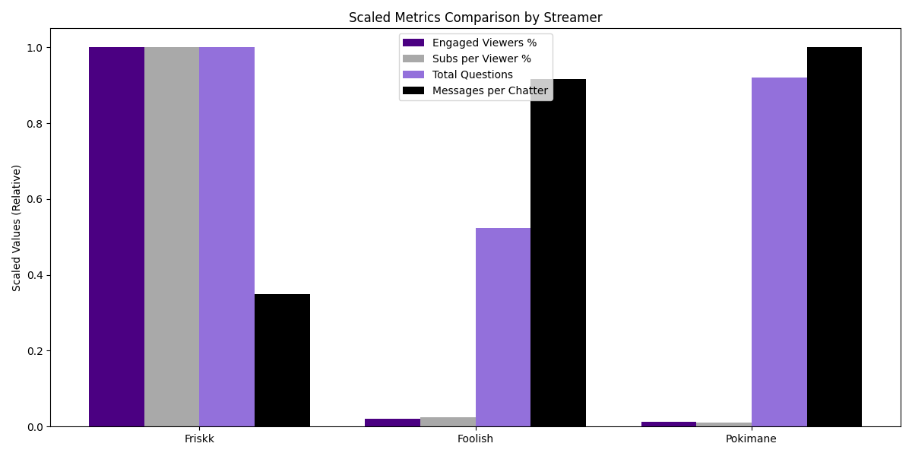
Engaged Results
 | Engaged
Streamer | % Engaged viewers | % Subs / viewer | Questions | Messages / Chatter
Friskk | 97.45% | 5% | 491 | 5
Foolish | 2.05% | 0.1% | 257 | 12
Pokimane | 1.14% | 0.05% | 452 | 113
Notes:
Frisk asks more questions to the chat and is a lot more engaging
Friskk has a higher sub per viewer rate because there is a smaller audience and she provides more of a personal experience that might lead someone to want to sub or gift a sub.
Engaged Vieweres % not good metric for increasing Twitch streamer success once you are above a certain threshold of viewers; however, valuable if you’re just starting out or have small audience because it allows you to build community and subs / followers

Slide 9
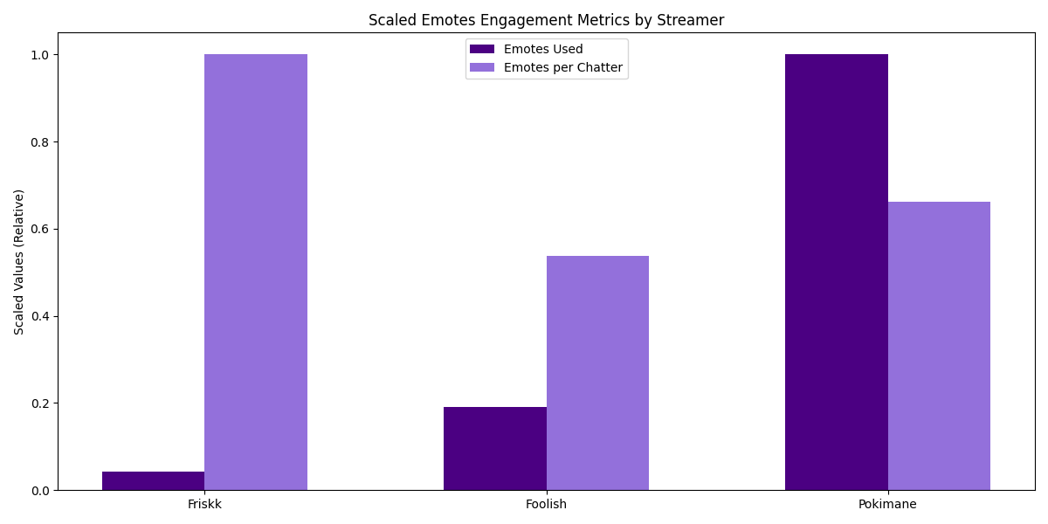
Amazing Results
 | Amazing
Streamer | Emotes / Chatter | Technical
Friskk | 0.67% | 6
Foolish | 0.56% | 2
Pokimane | 0.44% | 1
Notes:
Frisk asks more questions to the chat and is a lot more engaging
Friskk has a higher sub per viewer rate because there is a smaller audience and she provides more of a personal experience that might lead someone to want to sub or gift a sub.
Engaged Vieweres % not good metric for increasing Twitch streamer success once you are above a certain threshold of viewers; however, valuable if you’re just starting out or have small audience because it allows you to build community and subs / followers

Slide 10
Influential Results
 | Influential
Streamer | Sponsorship mentioners
Friskk | 0
Foolish | 0
Pokimane | 0
Notes:
Influential metrics did not yield any results as there were no third party business sponsorships mentioned during either of the streamers’ streams

Slide 11
Limitation & Future Work
Metrics to measure influential did not yield results
Sponsorship or business ventures difficult to capture via single stream
Future work: define new metrics for “influential” or look at more videos per streamer
# of outside business ventures or social media mentioned
= influence?
Notes:
The biggest limitation was the our influence metric did not yield any results especially since we only watched only one stream per streamer. Future work includes using a different metric to understand influence or getting data across more of their streams, respectively

Slide 12
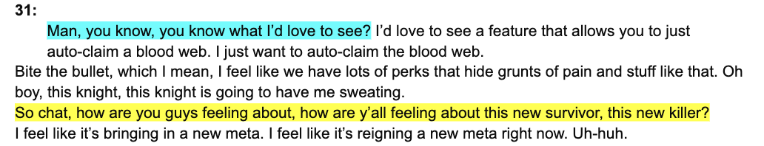
Limitation & Future Work
Metrics to measure questions directed at the chat using Python was not representative of streamer engagement with audience
Future work: manually count of questions directed at the chat to evaluate engagement
Notes:
Another issue was that we used Python to evaluate the questions directed at the streamer – which got us numbers within the hundreds. But upon manual review we discovered it was a fraction of that.
For example, you can see that the yellow is an actual question that the streamer is directing at the chat, while the blue is a question that is ask out loud, but not really towards the chat.
We didn’t find this out until later on, so future work would include a more thorough manual count of the videos.

Slide 13
Limitation & Future Work
Some of the metrics selected were limited by how many viewers were watching the channel
We had to normalize the data by creating a percentage; however, conducting any regression analysis on the raw data itself was inconclusive
Future work: define different engagement metrics per streamer tier
Unique chatters
X 100%
Total viewers
= % engaged viewers?
Notes:
Some of the metrics were difficult to do regression analysis on because it was limited by how many viewers were watching the channel.
The data was not very normalized. For example, take the % engage viewers metric. When you have more viewers, like on the top and mid tier streamer channels, its difficult to have a conversation, so its not that the viewers on that channel arent as engaged as on the low-tier streamer channel, there’s just no way for a conversation to occur other than spamming emojis or comments.
If we did this again we would explore different engagement metrics per streamer tier.

Slide 14
Limitation & Future Work
Similarities in results of top and mid-tier streamers → wrong threshold of “mid-tier streamer”
Future work: choose a mid-tier streamer with ~500k followers
Twitch Streamer | Follower Count
Pokimane | 9 million
Foolish Gamer | 2.2 million
Friskk | 50 thousand
Notes:
Given the similarities between top and mid-tier streamers, it’s possible we did not select an appropropriate threshold of followers for top vs. mid. ws. Low-tier.

Slide 15
Conclusions
For streamers who have a lot of > 1 million viewers, interactions for successful audience engagement look different than for streamers with < 50k (and vice versa)
Top Tier
Pokimane
9 million
Mid Tier
Foolish Gamer
2.2 million
Low Tier
Friskk
50,000
Notes:
Given this limitation regarding our top and mid tier segmentation, our main takeaways are that [read slide]
Streamers with a million plus have to focus on maintaining a crowd and creating an entertaining live chat
While streamers with followers in the thousands should focus on creating an intimate community to build their following

Slide 16
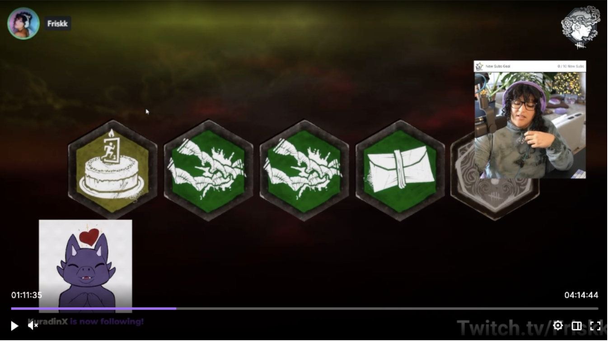
Conclusions
If you’re an up-and-coming streamer, focus on improving audience interactions by creating:
Collaborative dynamic streams with viewers
1:1 conversations
Good technical set-up
Good UX
Notes:
She talks with viewers, simultaneously interacting with them to create a good stream for the audience
She has more directed, personal conversations with each of her viewers
She has customized UI
When someone follows Friskkk, an animation pops up

Slide 17
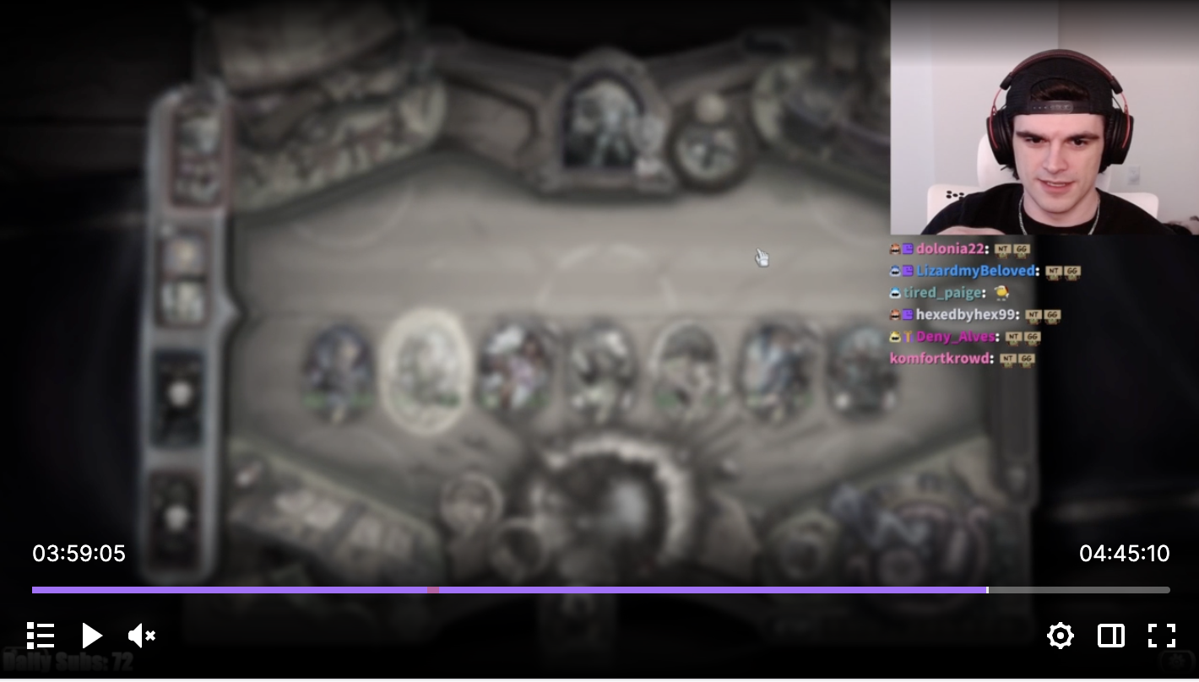
Conclusions
If you’re a popular streamer, focus on improving audience interactions by creating:
Entertaining, exciting experience
Chatters are using more emotes and chants
Simulate sporting event
Notes:
For more popular streamer who already have a following, they should focus on
Creating a very entertaining channel that viewers would like to consistently watch
Where the chat is very active and live
There are too many viewers for actual conversation to occur, so you need events that spark emotes and chants to create an exciting environment
Almost like simulating a sporting event, where crowds go wild
You can see in FoolishGamer, he’s playing a game and the chat if just spamming Emojis – which explains why each unique chatter had 100+ messages on the more popular streamer channels

Slide 18
Q&A
Notes:
Influential metrics did not yield any results as there were no third party business sponsorships mentioned during either of the streamers’ streams

Slide 19
Limitations #2
Some of the metrics selected were limited by how many viewers were watching the channel
We had to normalize the data by creating a percentage; however, conducting any regression analysis on the raw data itself was inconclusive
Unique chatters
X 100%
Total viewers
= % engaged viewers?
Notes:
When you have more viewers its difficult to have a conversation, so its not that they arent engaged
For top

Slide 20
Active Audience Engagement
1
Message Rate (Messages per Viewer)
Frequent messaging suggests active viewers
4
Donations/Tips
Financial Contributions tied to specific requests or moments (e.g. asking for specific game actions).
2
Count of Questions
Indicates attempts to initiate discourse with the streamer
5
Active Commands Usage
Engaging with bots or commands like !songrequests or !vote.
3
Emote Use:
The high usage of emotes during critical moments reflects active emotional engagement

Slide 21

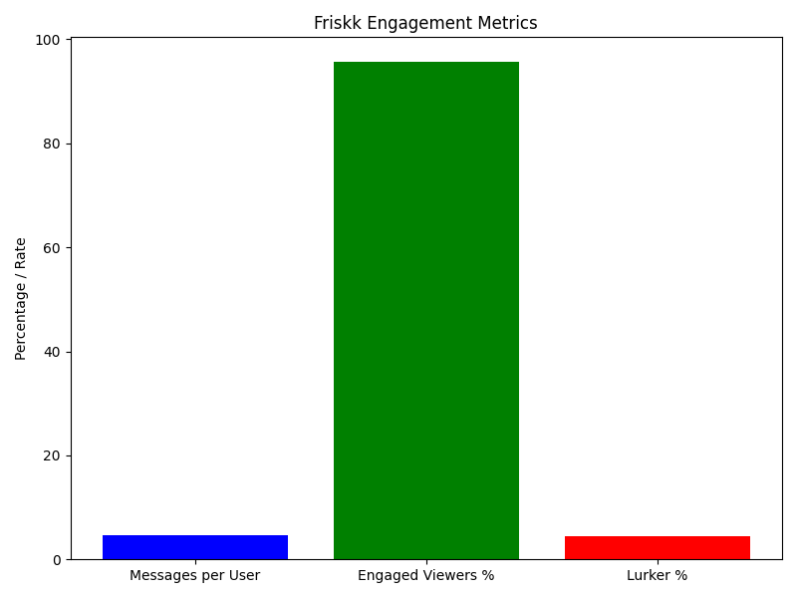
Streamer Metrics - Friskk
Engaged Audience: Friskk has the highest percentage of engaged viewers (97.45%), meaning nearly all viewers actively participate in chat. This suggests a highly dedicated, small community.
Message Dynamics: Despite the high engagement rate, the total message count (706) and message rate (4.61) are low compared to others, reflecting a slower-paced chat environment.
Lurkers: Friskk has the smallest proportion of lurkers (2.54%), reinforcing the idea of a close-knit community where most viewers actively participate.

Slide 22
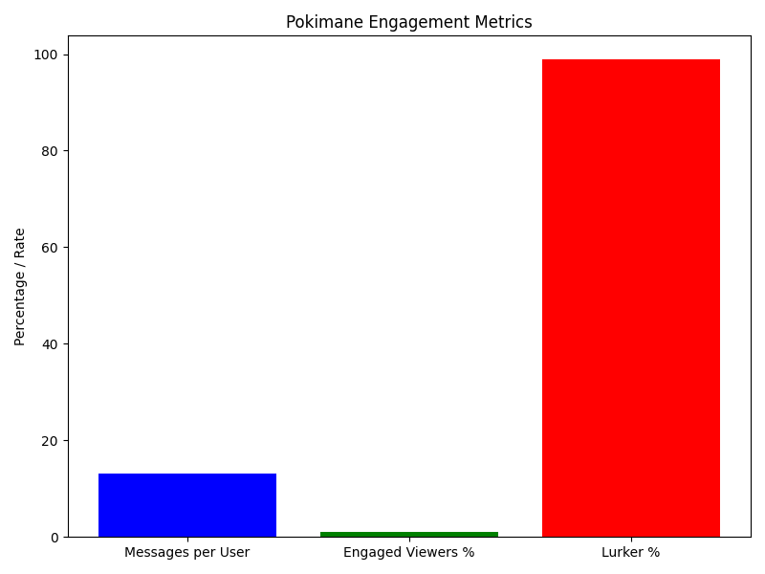
Streamer Metrics - Pokimane
Engaged Audience: Pokimane’s engaged viewer rate (1.14%) is the lowest, reflecting the challenges of engaging a massive audience (477,740 viewers).
Message Dynamics: Despite the low engagement rate, Pokimane achieves an impressive total message count (72,242), driven by a highly active subset of chatters.
Lurkers: With 98.85% lurkers, most viewers observe rather than participate, which is typical for large-scale streamers.

Slide 23
Passive Audience Engagement
1
View Count
Number of viewers, regardless of whether they interact.
4
Lurker Percentage
Ratio of viewers to active participants (calculated as [total viewers - active chatters] / total viewers
2
Followers Growth Rate
Passive viewers convert into followers without direct interaction during the stream
3
Unique Views
The total number of distinct viewers who joined the stream.

Slide 24
Streamer Metrics - FoolishGamer
Engaged Audience: This aligns with the larger viewer base (62,282 total viewers), where participation typically drops as audience size increases.
Message Dynamics: Foolish generates 15,511 messages with 1,278 unique chatters, resulting in a higher message rate (12.13). This reflects a moderately active community, likely sustained by a mix of die-hard fans and semi-active lurkers.
Lurkers: Foolish’s engagement rate is significantly lower at 2.05%, meaning most viewers are lurkers.

